Slide 1

Happy customers.........
.....is the basis for all Quality Management...

Slide 2
”Outstanding results through strategy, structure, culture, and continuous improvement”
Succesful, Quality Management of today relys on Continuous Improvement with continuous learning through:
The Structure – represents the logic for how the business is controlled
The Culture – the passion of people and the will to perform at their very best levl in all assignments, which creates the soil where the organisation can grow.
The Strategy gives the organisation direction in how to achieve the objectives and vision
Strategy
Continuous
Improvement
Structure
Culture

Slide 3
Management systems exist at different abstraction levels and for different purposes
‘Management Systems at all levels always have the Mission to connect and align strategies, proceses, results and continuous improvement’’

Slide 4



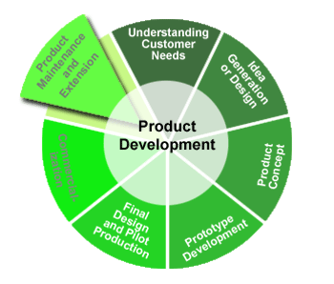


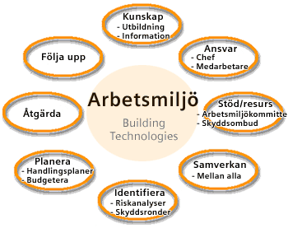


Examples on abstraction levels and dimensions for management systems
Factory
Production cell
R&D site
Global Corporation

Slide 5
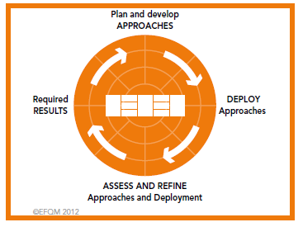
Continuous improvement
Plan – do – check – act Juran
Results – Approach – Deployment – Assessment –Refinement EFQM
Observe – Orient – Decide - Act Agile/Digitilisation
Dream – Innovate – Test/Reject –Scale up

